Slide 1
Variables

Slide 2
What is Variable?
Variable is a location in memory where a value can be stored for use by a program.
Variable must be declared, before they can be given a value.
Every variable has a name, a type, a value and a size.
You can’t use the keyword names to define a variable

Slide 3
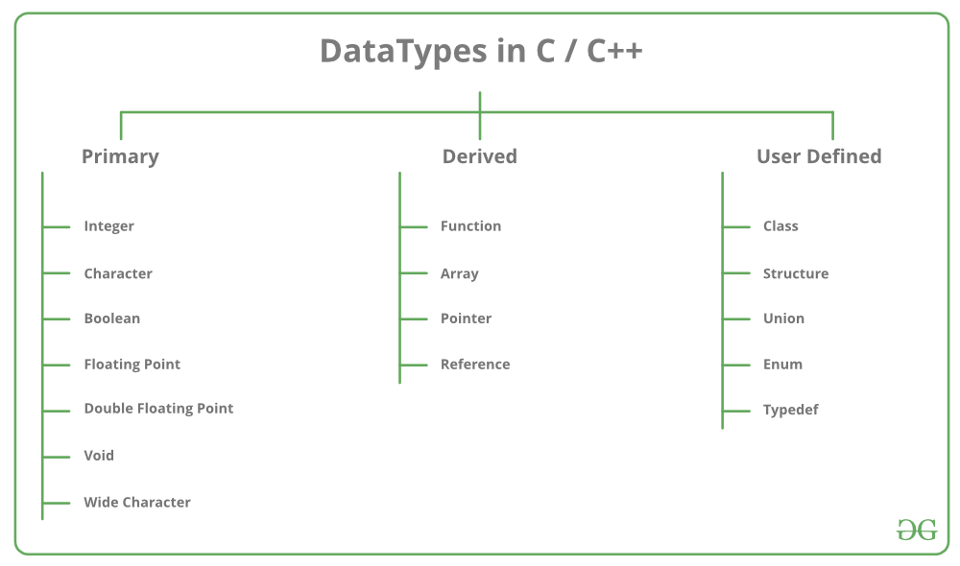
Data Types
char
int
float
double
https://www.geeksforgeeks.org/c-data-types/
https://www.geeksforgeeks.org/derived-data-types-in-c/
https://www.geeksforgeeks.org/user-defined-data-types-in-c/

Slide 4
Variable Names
Can be a series of characters consisting of letters, digits and underscores
Does not begin with a digit
No spaces between characters
May not be a reserved word. (for, while, int)
C is case sensitive

Slide 5
Variable Declaration
<data type> <name of the variable>;
char letter;
int number;
float average;
double area;

Slide 6
Variable Initialization
The assignment operator can be used to store a value in a variable.
variable(left value) = expression(right value);
It stores the value of the expression into the memory location for the variable.

Slide 7
Quiz
What is the value for number?
int number;
number = 90 + 10;
What is the value for points?
int points = 0;
points = points + 1;

Slide 8
Display Variables
#include <stdio.h>
int main(void){
int a;
a = 10;
printf(“%d”, a);
}
Variable declaration
Variable initialization
variable
format specifier
Format specifier that describes the output format.

Slide 9
Format Specifier
Specifier | Used for
%c | A single character
%s | A string
%f | A floating point number for floats
%lf | A floating point number for doubles

Slide 10
Data Types Example
printf(“%d”, 120);
printf(“%d”, -120);
printf(“%f”, 50.3463);
printf(“%.2f”, 50.3463);
printf(“%c”, ‘A’);
printf(“%s”, “peter”);

Slide 11
Let’s try to do something!

Slide 12
Constant Variables
The qualifier const can be applied to the declaration of any variable to specify that its value will not be changed.
const int pi = 3.142857143
variable name
value
data type
const keyword
the value of the constant should be assigned at the declaration time.

Slide 13
Preprocessor Constants
We can create constants using preprocessor.
Preprocessor is an editor, it perform search and replace task.
#define pi 3.14
Search text
Replace text
command

Slide 14
Getting User Input
We use scanf function to get user inputs
int a;
scanf(“%d”, &a);
Format specifier
Address of the variable as argument

Slide 15
Let’s make simple calculator by getting user inputs!

Slide 16
C Structures
Simply a structure is a collection of related variables under one name.
May contain variables of different types
Keyword struct is used to declare a structure.

Slide 17
Structure Definition
identifier
struct student{
int regNo;
int age;
int grade;
char gender;
}student1, student2;
members
variables

Slide 18
Accessing Members of a Structure
Input
scanf(“%d”, &student1.regNo);
Print
printf(“%d”, student1.regNo);
Assign
student1.gender = ‘M’;

Slide 19
Let’s try to do something!

Slide 20
Summary
Variables
Data types
Constants
Format specifier
Printf statement
Scanf statement
Structures

